Slide 1
Assignment 2
Keeran Ravishankar (216387771)
CheukWai Chan (218464057)
Domenico Lasalandra(217125105)
Peipei Yu (215869753)

Slide 2
Introduction
The internet provides people with fast and easy access to communication and information.
But with access to social media, electronic mail, audio/video transmission a new threat to safety emerges.
This threat is compromised online security.
It is important to have security measures when using or accessing the internet as personal information can be easily leaked and accessed by the wrong people.

Slide 3
Assignment 2: Instructions
So for this assignment, we are attempting to implement themes and issues learned in class.
The assignment’s objective is to build a web information system by using XML and servlet.
The programming portion should contain two parts.
Dynamic web pages
The prototype secured web information system.
The web information system must contain login pages, information content pages and a logout button on each page.
The web security portion should contain restrictions on what a logged in user can/can’t do. These restrictions can include no copying/pasting text, no printing of the webpage, no access unless the user is logged in and so fourth.

Slide 4
Description of The Website
The website consists of a login and the home page. The contents of the homepage consists of the books sorted by the title, genre, author, and description. The page allows a user to login using an account and you can look at the library of books.
There are also several security measures on the page such as user not being able to use the back button to login, user login is the only way to access the page, Images/text are not copyable, printable or savable and the server side is protected.

Slide 5
Languages we Used
XML
HTML
JSP
Simple text-based format for representing structured information.
Standard markup language for documents on the web.
Help dynamically generate web pages.

Slide 6
Table of contents
01
Web Xml
04
Data Servlet
02
Login Handle Servlet
05
Login Jsp
03
Logout Handle Servlet
For the Java Web Application
Handles all the GET request
Defines a login form in HTML and CSS
Handles the login requests and implements the doPost methods
Used to handle the logout request

Slide 7
Table of contents
07
08
Catalog XML
Books XSL
contains the characteristics of elements such as author.
Stylesheet for Books pages

Slide 8
Web XML
starts with the declaration of the web-app element and specifies the XML namespaces being used in the version of the Java servlet specification.
The welcome-file-list element gives a list of the default pages that the web container needs to look for when a client makes a request to the root of the application.
The servlet elements define servlets that handle requests from clients. Each servlet element has a servlet-name and a servlet-class. Servlet-mapping elements map servlets to URL patterns that clients use to access them.
The URL patterns must match the value of the action attribute in either the Html page or the Jsp page. The three Java servlets loginHandle, logoutHandle, and dataServlet have their own unique URL pattern.

Slide 9
Login Handle Servlet
The doPost method retrieves the userId and pwd parameters from the HTTP request object using getParameter method.
An HttpSession object is created and it is used to store session attributes.
The type of the response is html and a PrinterWriter object is the one that writes the response to the object.
If the User ID and password match then you are able to access the home page as the session attribute login_status is set to login.
If the User ID and password doesn't match then the login_status has failed and the user is just taken back to the login page.

Slide 10

Logout Handle Servlet
It extends the HttpServlet class and overrides the doGet and doPost methods to handle both the HTTP GET and POST requests.
The doPost method invalidates the current session using the invalidate method and redirects the user to the login page using the sendRedirect method

Slide 11
Data Servlet
Converts XML files to HTML using an XSL stylesheet and it returns the HTML to the client.
The code starts getting some response headers to ensure that the page is not cached.
Checks if the user is logged in by checking if the login_status attribute is set for the session.
The current implementation of the code reads the files from a hard-coded file path

Slide 12
Login JSP
The form authenticates users and allows them access to restricted areas of the website.
The form action attribute is set to login where the form data will be received.
The form method is set to post so the form data will be sent in the request body.
The CSS styles define the appearance of the form and its elements.
Warning messages are also displayed if any users enter incorrect credentials.

Slide 13

Catalog XML
The catalog XML code contains the characteristics of elements such as author, title, genre, price and publish date.
The Catalog XML file is also linked to the XSL stylesheet called books.Xsl.
The XSL stylesheet helps the XML file become presentable to the user viewing the web page in the browser.

Slide 14

Books XSL
The stylesheet defines the design and layout of the HTML page and it displays a catalogue of books.
The background colour, font family, size, text, and styling for the navigation bar and buttons are all defined in this XSL sheet.
The style sheet contains XSLT code that selects and iterates over a set of XML elements which are the books in the catalogue.
Each book creates an HTML <div> element that displays the book's characteristics such as title, author, genre, etc.
The Stylesheet includes a form with buttons as well to filter out books in the catalogue by genre.

Slide 15
Website walkthrough

Slide 16
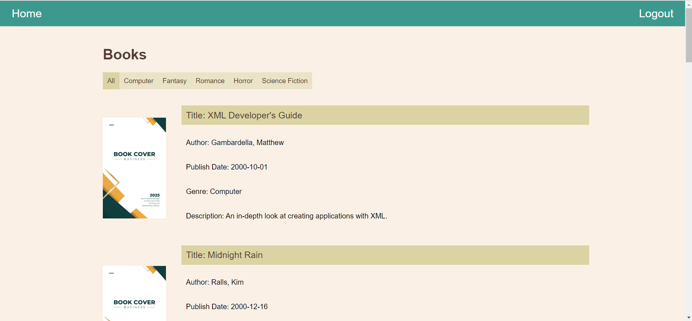
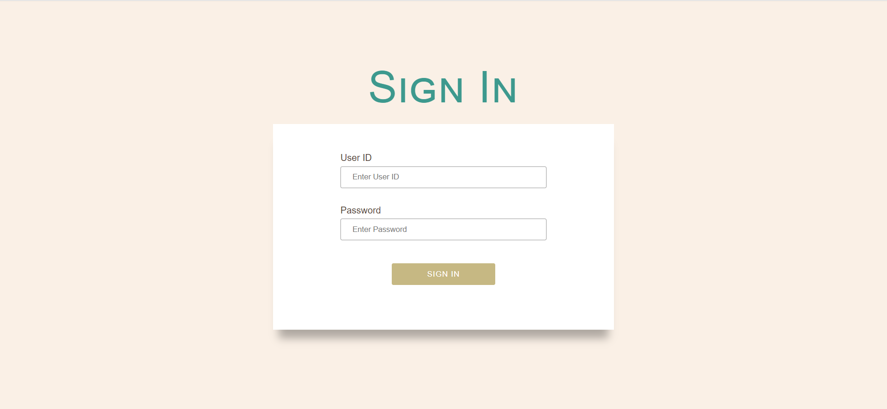

Slide 17
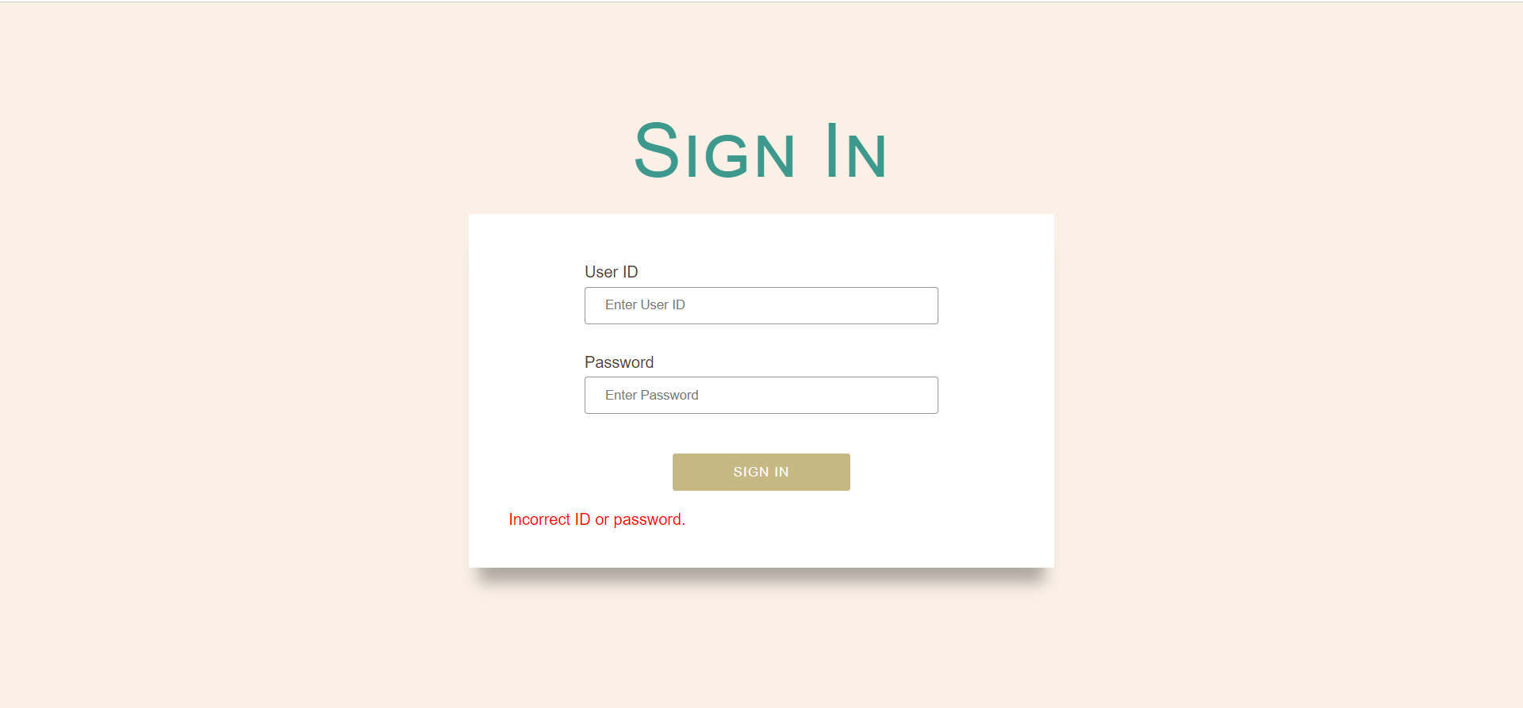

Slide 19
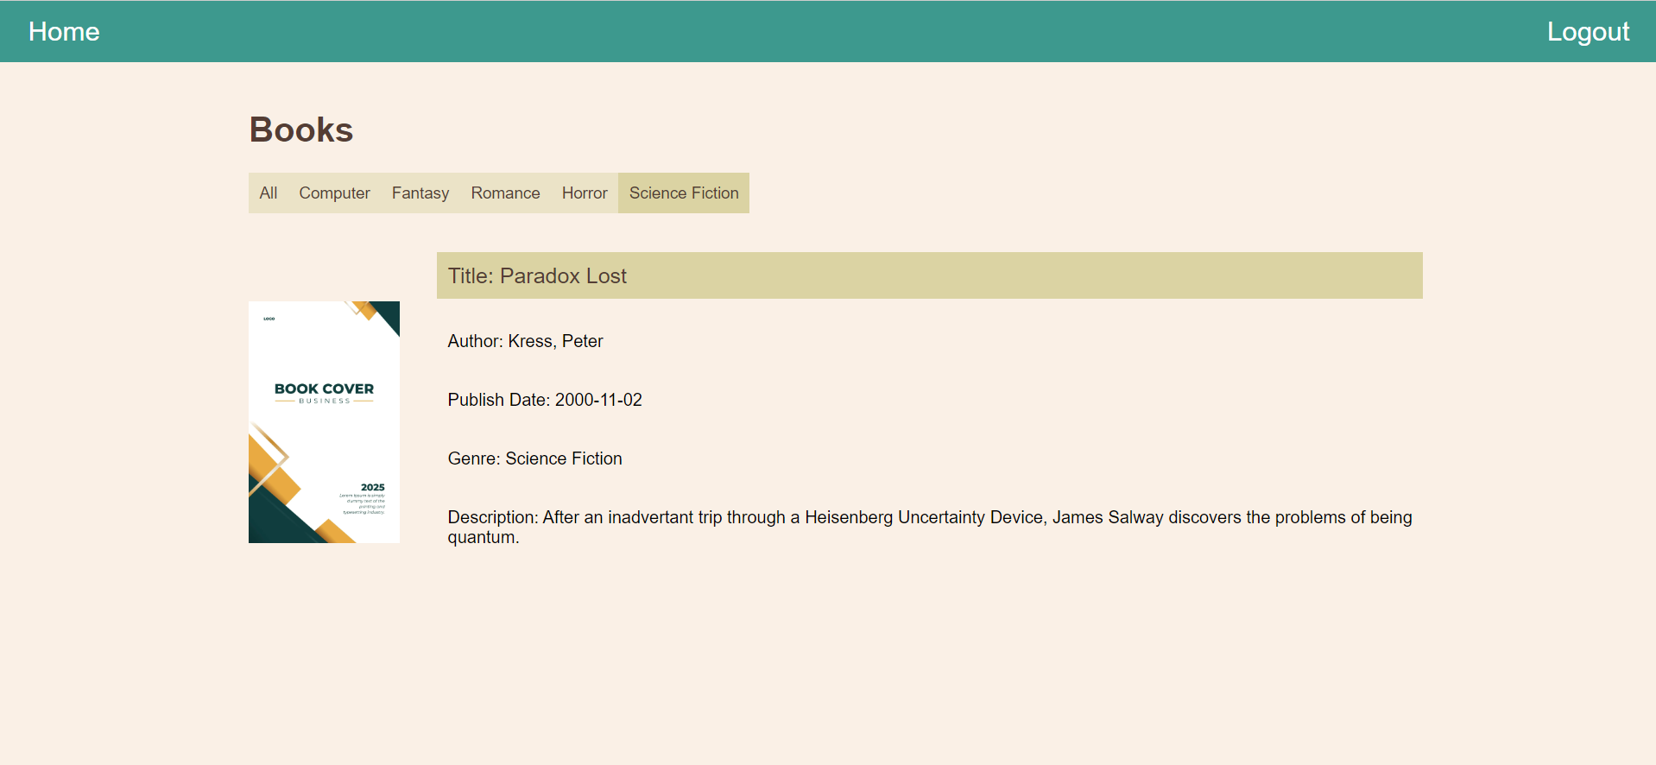

Slide 20


Slide 21
Web Information System
Security Measures

Slide 22
User Authentication
Provide ID and password
User's credentials must match the credentials of authorised users
Login failed -> not redirect to the home page
Blocking out unauthorized user from accessing the data inside

Slide 23
User Authentication
After logged in: new session and attribute “login_status” = “login”
In home page -> checking if “login_status” = “login”, otherwise redirect to login page
After logged out: session destroyed (login_status”=null) -> back to login page
Return button or types in the URL -> not redirect back to home page

Slide 24
Access control
Authorised users can only view the data is displayed on the home page
No copying text/ downloading images
Security measures on the client side:
Right click and selecting function are disabled
No content is displayed when printing the website
CSS: body{-webkit-user-select: none ;-ms-user-select: none; user-select: none; }
JavaScript: document.addEventListener('contextmenu', event => event.preventDefault());
CSS: @media print {html, body {display: none;}}

Slide 25
Access control
Security measures on the server side
images are converted to base64
Used in the html response
Path of the image will not be shown on the source code
Unable to download images and see the path of images on the server directory

Slide 26
Conclusion
05.

Slide 27
Thanks!
Do you have any questions?

